Slide 1
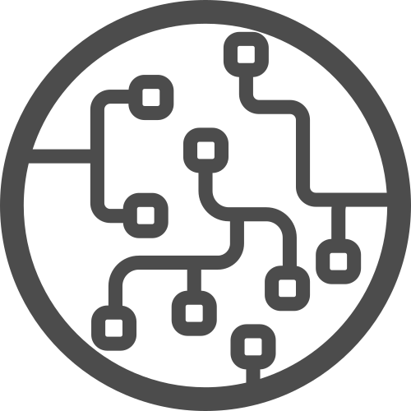




DAY-5
Classification, Transfer Learning, and Deployment

Slide 2



Instructor
From: Prodi Teknik Elektro, Institut Teknologi Bandung
Social Media:
Cynthia Evani
@cynthiaevani
Certification:
Google IT Automation with Python
Google Tensorflow Developer
AWS Certified Cloud Practitioner
Experience:
Machine Learning Student, Bangkit Academy (2021)
Machine Learning Engineer, PT Nomura Research Institute Indonesia (2021 - )
Cynthia Evani
DKI Jakarta

Slide 3
Classification

Slide 4
Classification
Classification may be defined as the process of predicting class or category from observed values or given data points.
Unlike regression, the output variable of classification is a category, not a value.
Classification takes labeled input data, which means it contains input with the corresponding output.
Two types of classification:
Binary classification
Multiclass classification

Slide 5
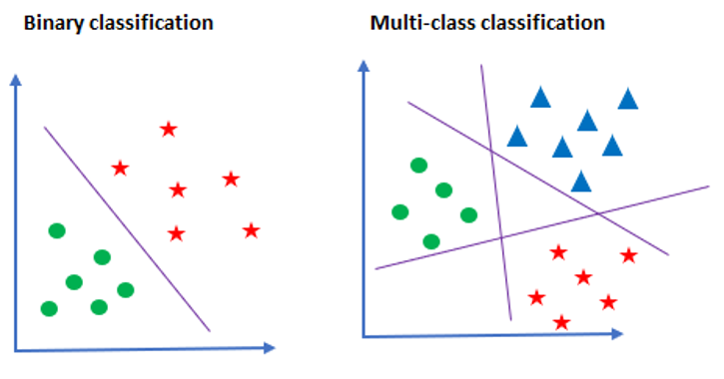
Classification

Slide 6
Classification with Neural Network
→ go to Iris colab

Slide 7
Computer Vision

Slide 8
Computer Vision
A field of AI that enables computers and systems to derive meaningful information from digital images, videos and other visual inputs — and take actions or make recommendations based on that information.
Computer vision is the field of having a computer understand and label what is present in an image.

Slide 9
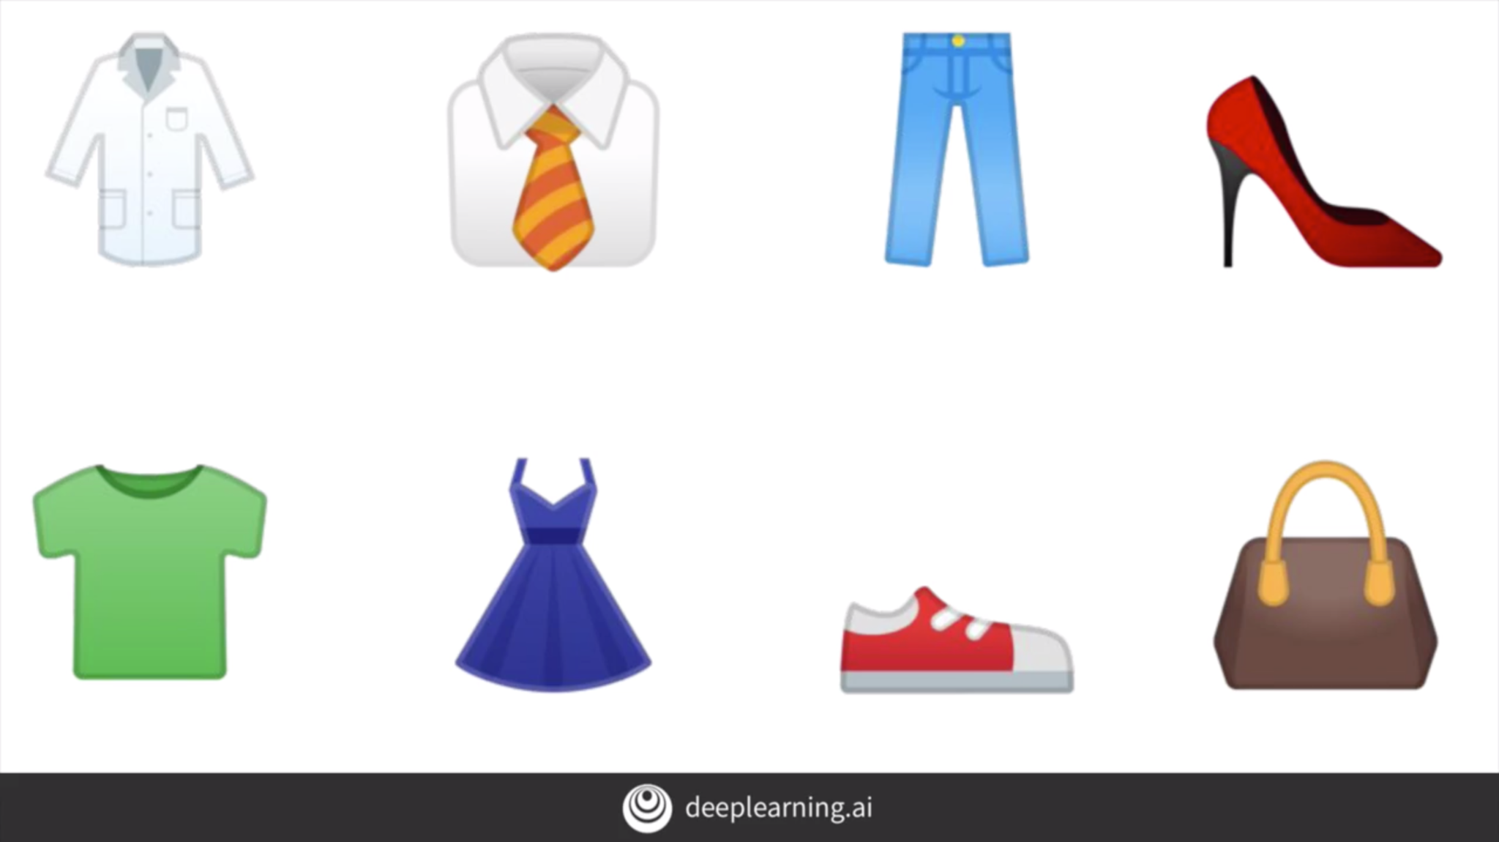
Computer Vision
Take clothing items for example.
Humans can easily distinguish items, but how about computers?
Use lots of pictures of clothing and tell the computer what that's a picture of and then have the computer figure out the patterns

Slide 10
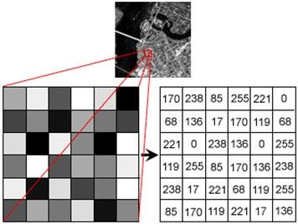
Image Attributes
Every image has a shape (width and height).
The colors of the pixel (intensity) is usually represented by numbers between 0-255.
Consider a grayscale image. The image can be represented in an array as follows.

Slide 11
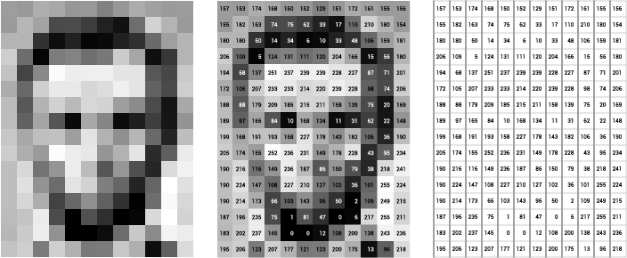
Image Attributes
Another grayscale image example.

Slide 12
Image Attributes
We can conclude that grayscale images can be represented in 2D arrays.
Array shape: (width, height)
Colored images have separate arrays for each channel (Red, Green, and Blue), so RGB images are represented in 3D arrays.
Array shape: (width, height, num_channels)

Slide 13
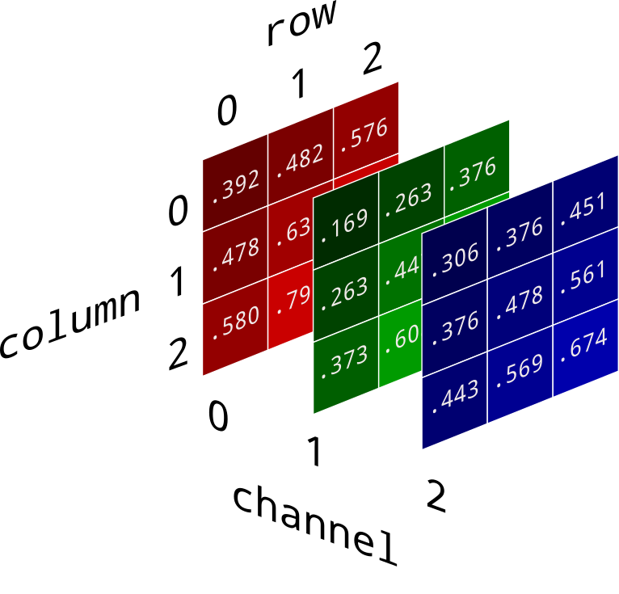
Image Attributes
An example of RGB image array.

Slide 14
Image Attributes
It is a good practice to normalize pixel values from [0-255] to [0-1] when processing image using neural networks.
Neural networks process inputs using small weight values, and inputs with large integer values can disrupt or slow down the learning process.
Normalizing pixel values are as simple as dividing the pixel value with 255.

Slide 15
Fashion MNIST
A dataset containing 70,000 images spread across 10 different items of clothing.
Each image has been scaled down to 28 x 28 pixels.
Usually, the smaller the size the better.
Note that the image still has to retain enough information to differentiate each classes.

Slide 16
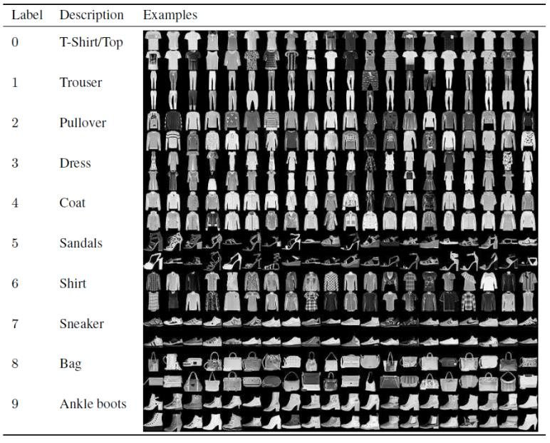
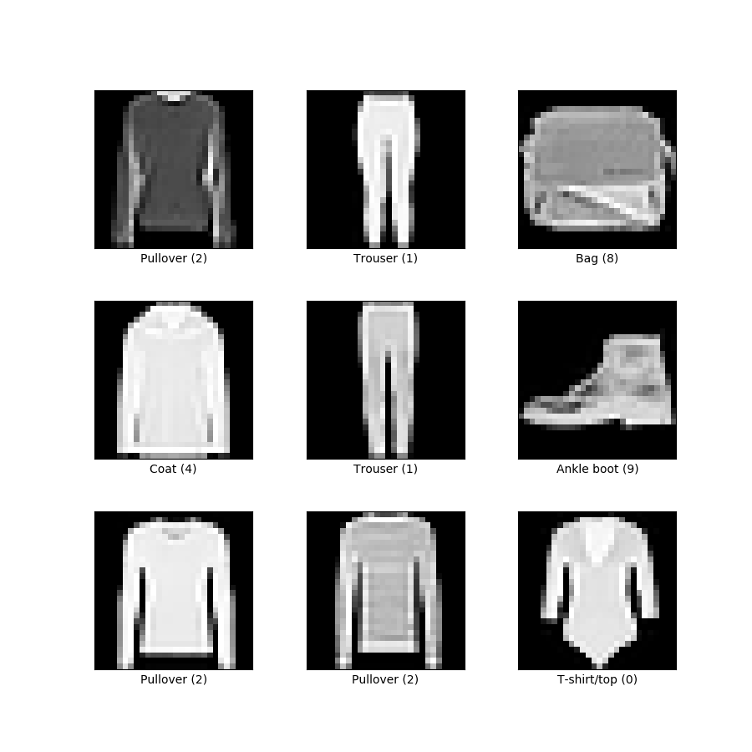
Fashion MNIST
Dataset example.
→ go to fashion_mnist.ipynb

Slide 17
Convolution and Pooling
In image processing, convolution is the process of transforming an image by applying a kernel over each pixel and its local neighbors across the entire image.
Kernel is a matrix of values whose size and values determine the transformation effect of the convolution process.
Some convolutions will change the image in such a way that certain features in the image get emphasized.

Slide 18
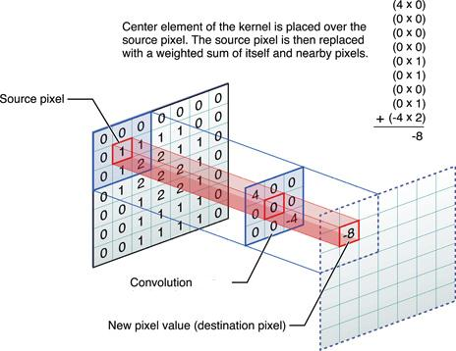
Convolution and Pooling
Convolution example.

Slide 19
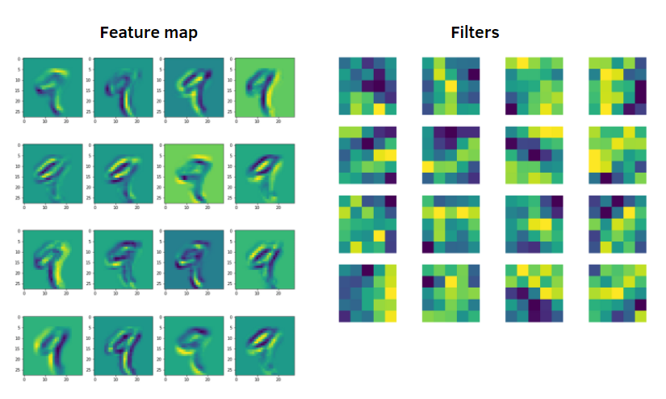
Convolution and Pooling
Convolution example.

Slide 20
Convolution and Pooling
Pooling is the process of extracting the features from the image output of a convolution layer.
Pooling layers are used to reduce the dimensions of the feature maps.

Slide 21
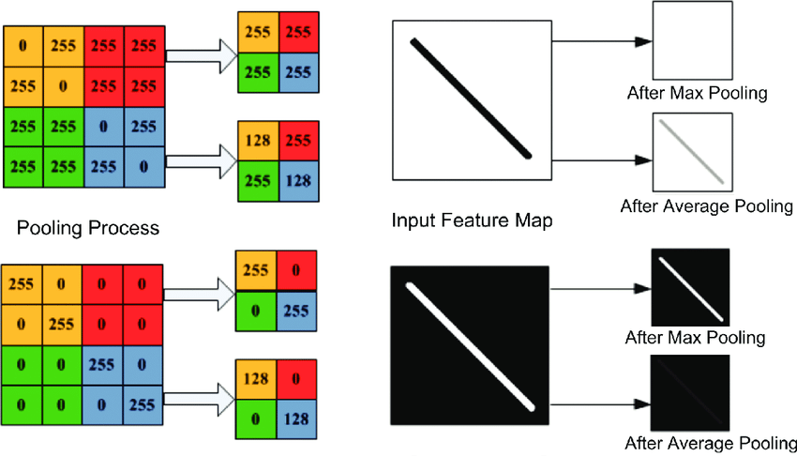
Convolution and Pooling
Pooling example.

Slide 22
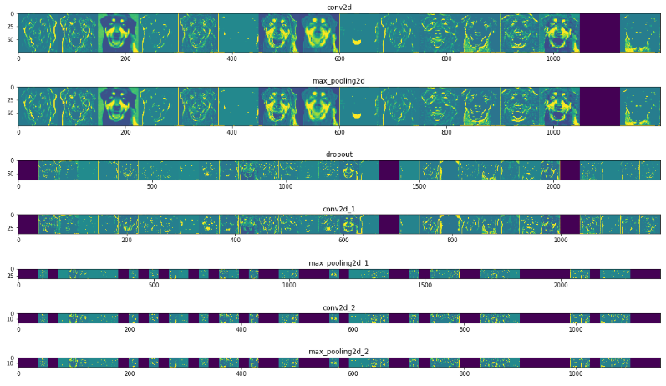
Feature Maps derived from Convolutions

Slide 23
Convolution and Pooling Notebook
→ go to exploring_convolutions.ipynb
→ go to fashion_mnist_conv.ipynb

Slide 24
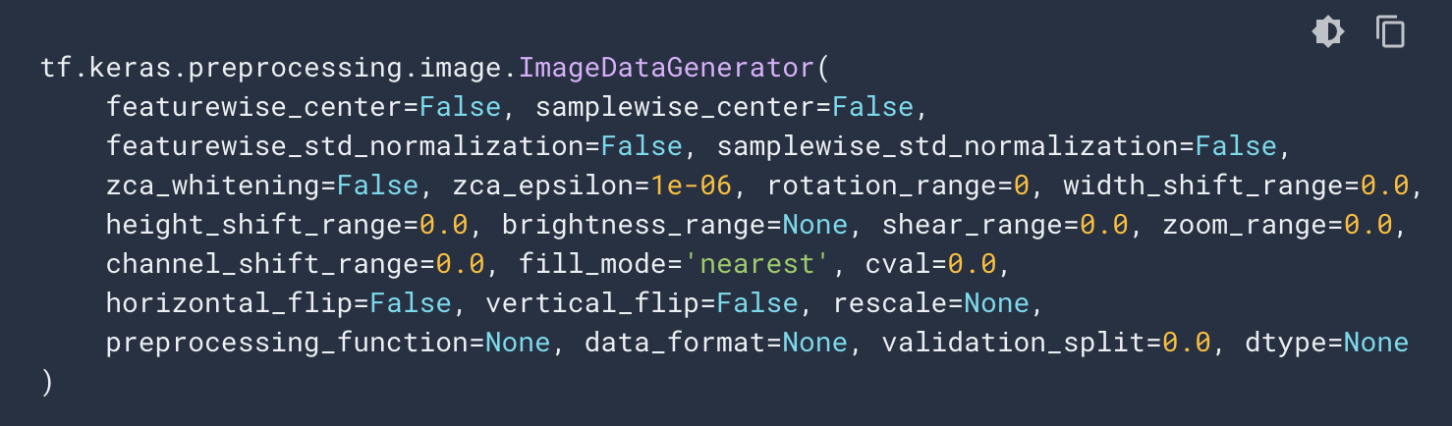
ImageGenerator
Real world data is a bit messier than the Fashion MNIST dataset.
Images might have different sizes and different aspect ratios.
The subject can be in different locations.
Data is not yet split into training and testing.
ImageGenerator is a Tensorflow API which can generate labels from directories and perform image preprocessing.

Slide 25
ImageGenerator
→ go to image_generator_with_validation.ipynb
→ go to cats_vs_dogs.ipynb

Slide 26
Image Augmentation
Image augmentation is a technique to increase the diversity of your training set by applying random (but realistic) transformations.
Benefits of image augmentation: improving prediction accuracy and reducing costs of labelling and collecting data.
adding more training data into the models
preventing data scarcity for better models
reducing data overfitting and creating variability in data
increasing generalization ability of the models
helping resolve class imbalance issues in classification

Slide 27
Types of Image Augmentation
padding
random rotating
re-scaling,
vertical and horizontal flipping
translation (image is moved along X, Y direction)
cropping
zooming
darkening & brightening/color modification
grayscaling
changing contrast
adding noise
random erasing

Slide 28
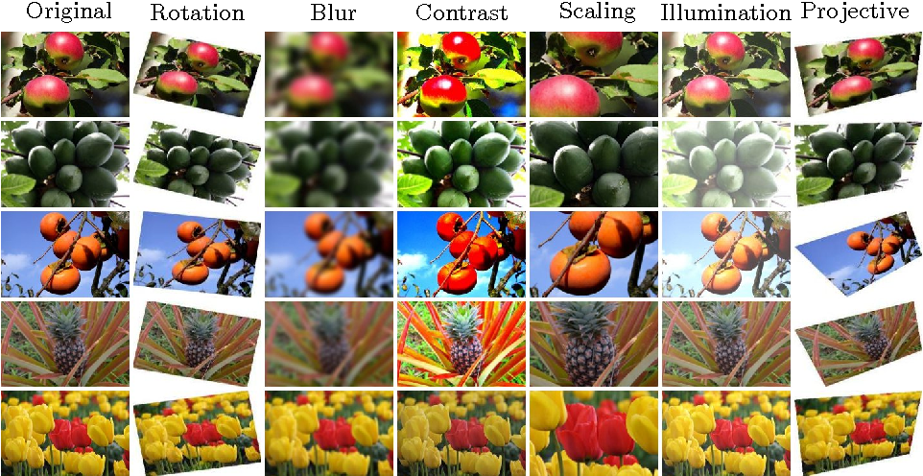
Image Augmentation

Slide 29
Image Augmentation Notebook
→ go to cats_vs_dogs_augmentation.ipynb

Slide 30
Multiclass Classification Notebook
→ go to multiclass_rps.ipynb

Slide 31
Transfer Learning

Slide 32
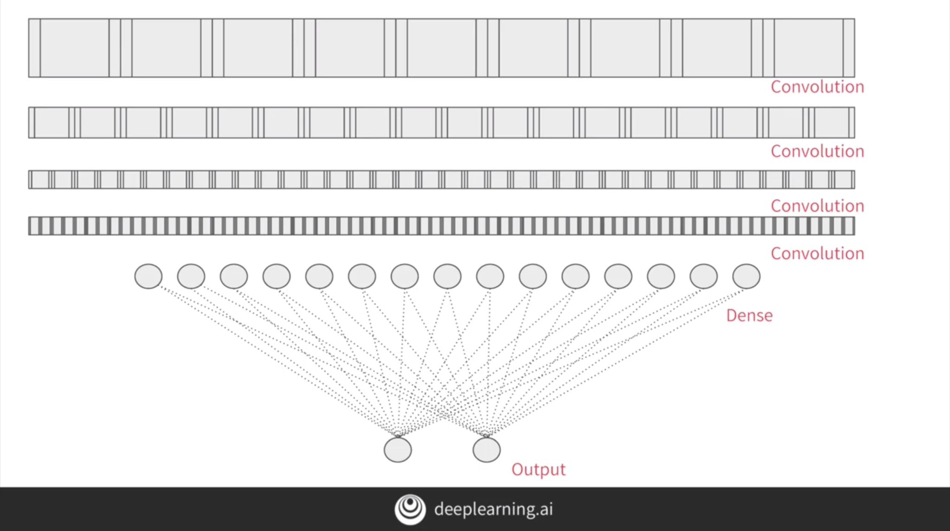
Transfer Learning
For example, we have a CNN that we built from scratch as follows.

Slide 33
Transfer Learning
Consider somebody else's model, with more complex layers and trained on a lot more data.
They have convolutional layers and they'reintact with features that have already been learned.
We can take a model that has been trained on a very large datasets and use the convolutions that it learned when classifying its data.
We only need to retrain the dense layers from that model with our data.

Slide 34
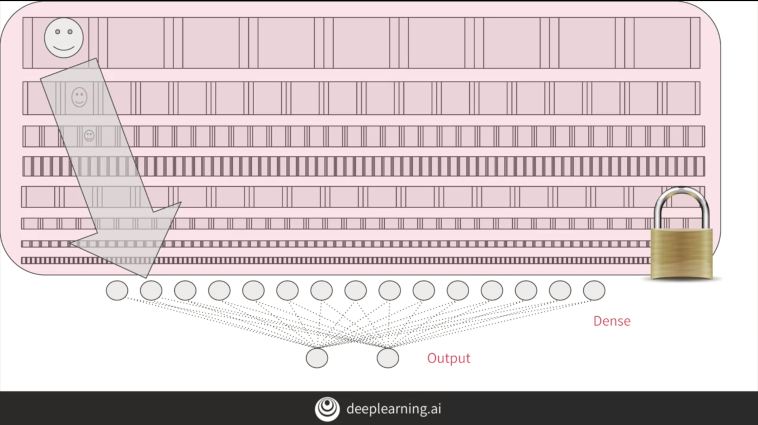
Transfer Learning
Transfer learning model is visualized as follows.

Slide 35
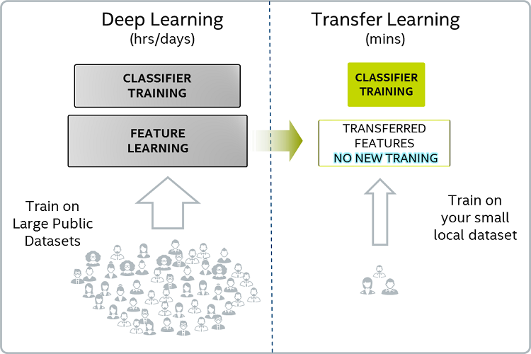
Comparison DL vs TL

Slide 36
Transfer Learning Notebook
→ go to transfer_learning.ipynb

Slide 37
Deployment

Slide 38
Saving Keras Models
We can save our model either by saving the checkpoints or saving the entire model.
Checkpoint is the weights of the model which are updated at each epoch.
When we save the entire model, we have two options: HDF5 or PB

Slide 39
Saving Keras Models
Format | Advantages | Disadvantages
HDF5 | Used to save giant data (so some neural networks would fit well) Common file saving format Everything saved in one file (weights, losses, optimizers used with keras etc.) | Harder to use in production (not compatible with Tensorflow Serving)
PB | Really small and efficient to parse Used by Tensorflow's Serving when you want to take your model to production Language agnostic - binary format can be read by multiple languages Advised to use since tf2.0 Saves various metadata (optimizers, losses etc.) | SavedModel is conceptually harder to grasp than single file Creates folder where weights are

Slide 40
Save and Load Model Notebook
→ go to save_and_load.ipynb

Slide 41
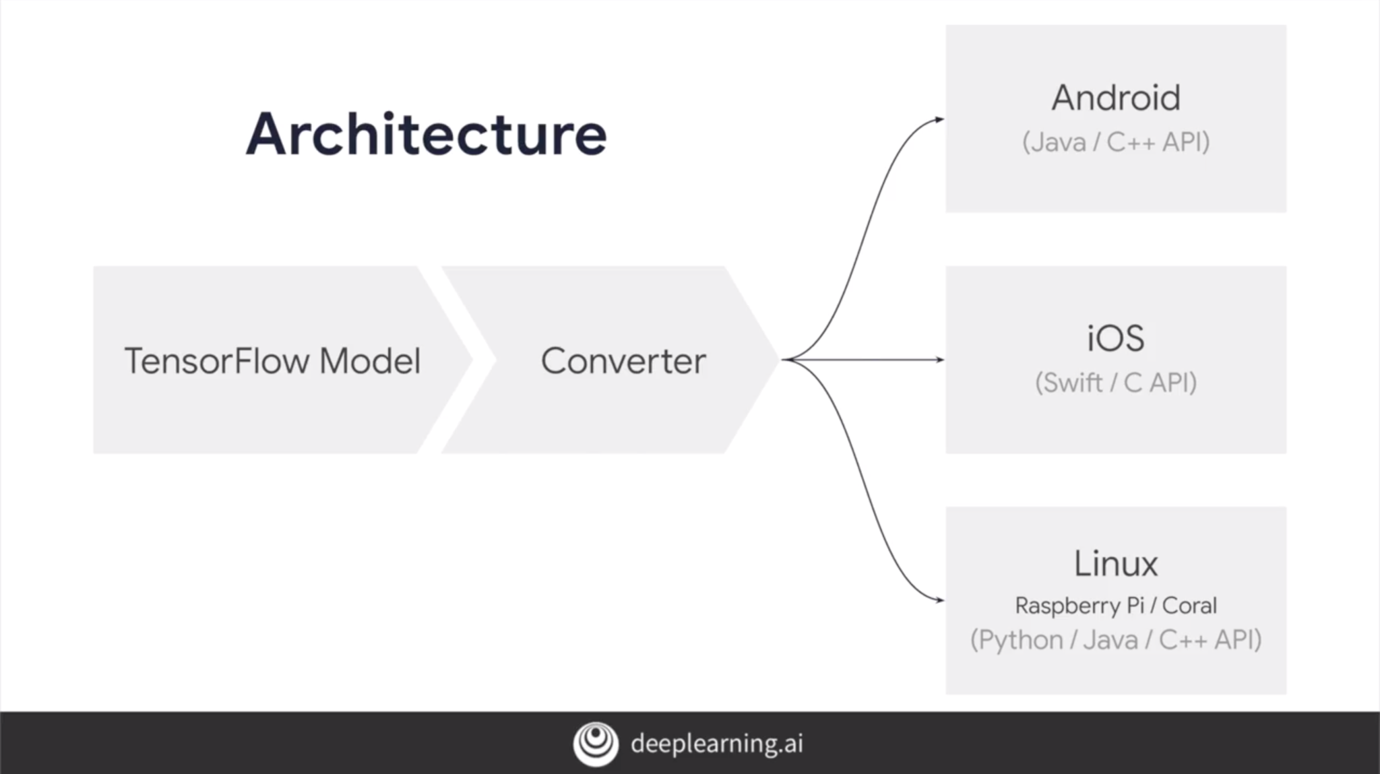
TensorFlow Lite
TensorFlow Lite is solution designed to run on mobile platforms.
Features: lightweight, low-latency, privacy, improved power consumption, efficient model format, pre-trained models.

Slide 42
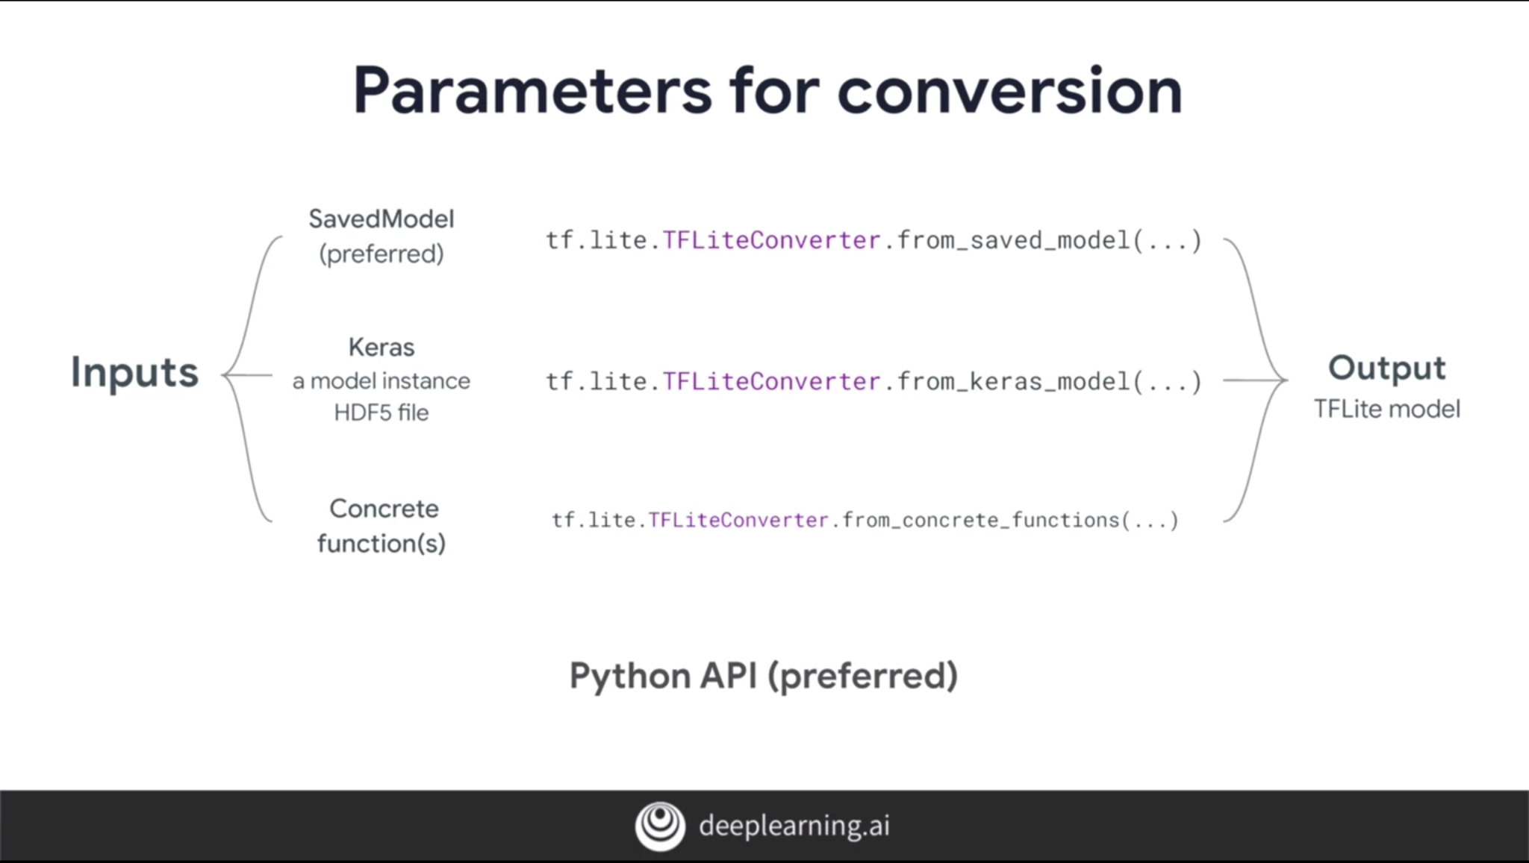
TFLite Converter
We can convert SavedModel, HDF5 model, or concrete functions to TFLite with TFLite Converter.

Slide 43
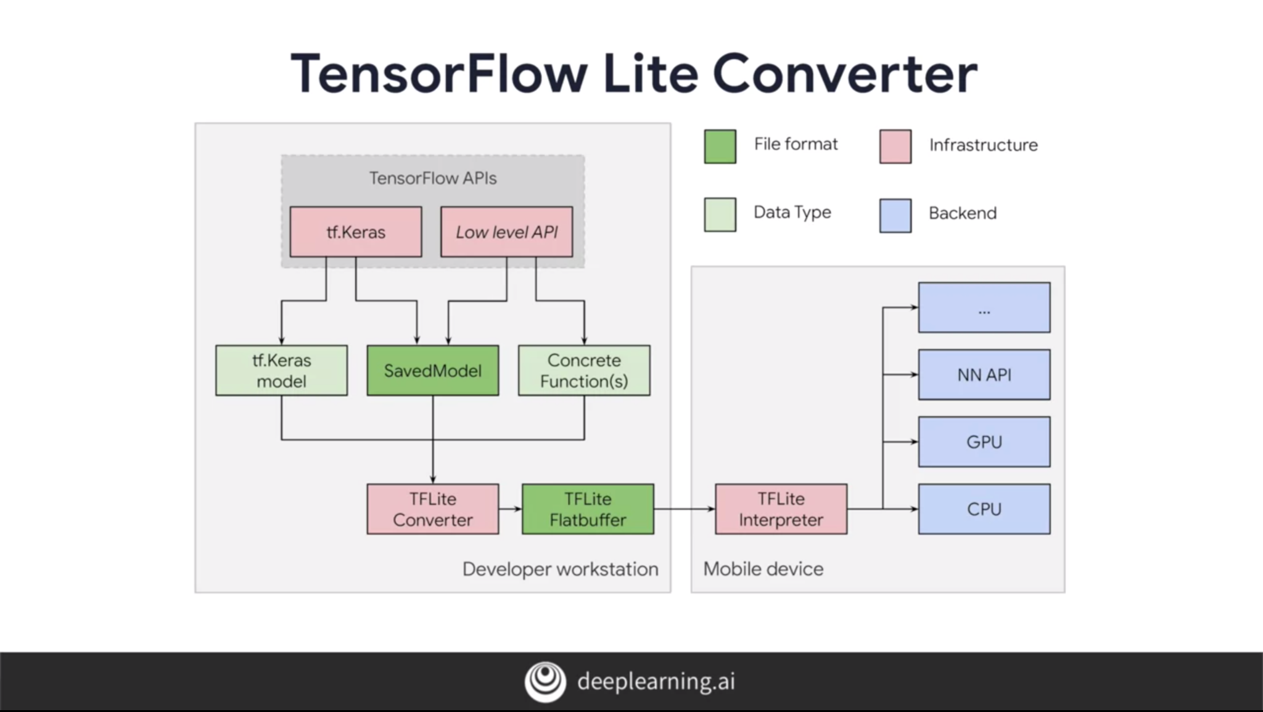
Conversion Process

Slide 44
Post-Training Quantization
Quantization converts all the floats in the weights of the model into ints.
Quantization reduces latency with little degradation in accuracy.
Optimization modes:
Default (size and latency)
Size
Latency
Quantization target specification: FP32 or INT8.
→ go to tflite.ipynb

Slide 45
ML Tips

Slide 46
Overcoming Overfitting
Data augmentation.
Remove some features from data.
Shuffle dataset or use cross-validation.
Reduce model complexity (remove layers, use DropOut, etc.)
Early stopping or reduce number of epochs.
Train with more data. → not guaranteed

Slide 47
Overcoming Underfitting
Train with more data.
Add more features to data.
Data augmentation.
Increase model complexity (add layers, add more neurons, etc.)
Increase the number of epochs.
Use transfer learning.

Slide 48
Model Not Converging
Check for irregularities in dataset.
Reduce learning rate.
Change activation function.
Change model architecture.

Slide 49
Effects of Changing Hyperparameters
Hyperparameter | Larger Value | Smaller Value
epochs | Model trains for longer, risk of overfitting. | Model trains for shorter, risk of underfitting.
batch size | Slow, guaranteed to converge, poor generalization. | Fast, not guaranteed to converge, better generalization.
learning rate | Model trains faster but might be divergent (not converge). | Model trains slower but will eventually converge.

Slide 50
General Tips
Define the problem clearly.
What is the goal?
Which kind of ML problem is this?
What data do we have?
Don’t be afraid to experiment with your machine learning code, especially hyperparameters.
GitHub and StackOverflow is your best friend.
Utilize cloud resources over local resources as long as you can.
It’s normal to not remember some syntax, you can always Google it. It’s more important to understand the concepts.
If your training takes a long time, you might want to save checkpoints since Google Colab disconnects runtime easily.

Slide 51
References
DeepLearning.AI TensorFlow Developer Coursera
Neural Network Design, Hagan
https://www.tutorialspoint.com/machine_learning_with_python
https://research.aimultiple.com/data-augmentation/
https://github.com/https-deeplearning-ai/tensorflow-1-public
https://www.tensorflow.org/tutorials/

Slide 52
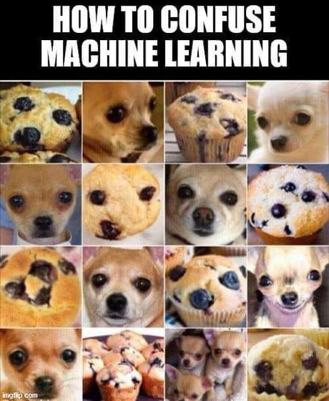
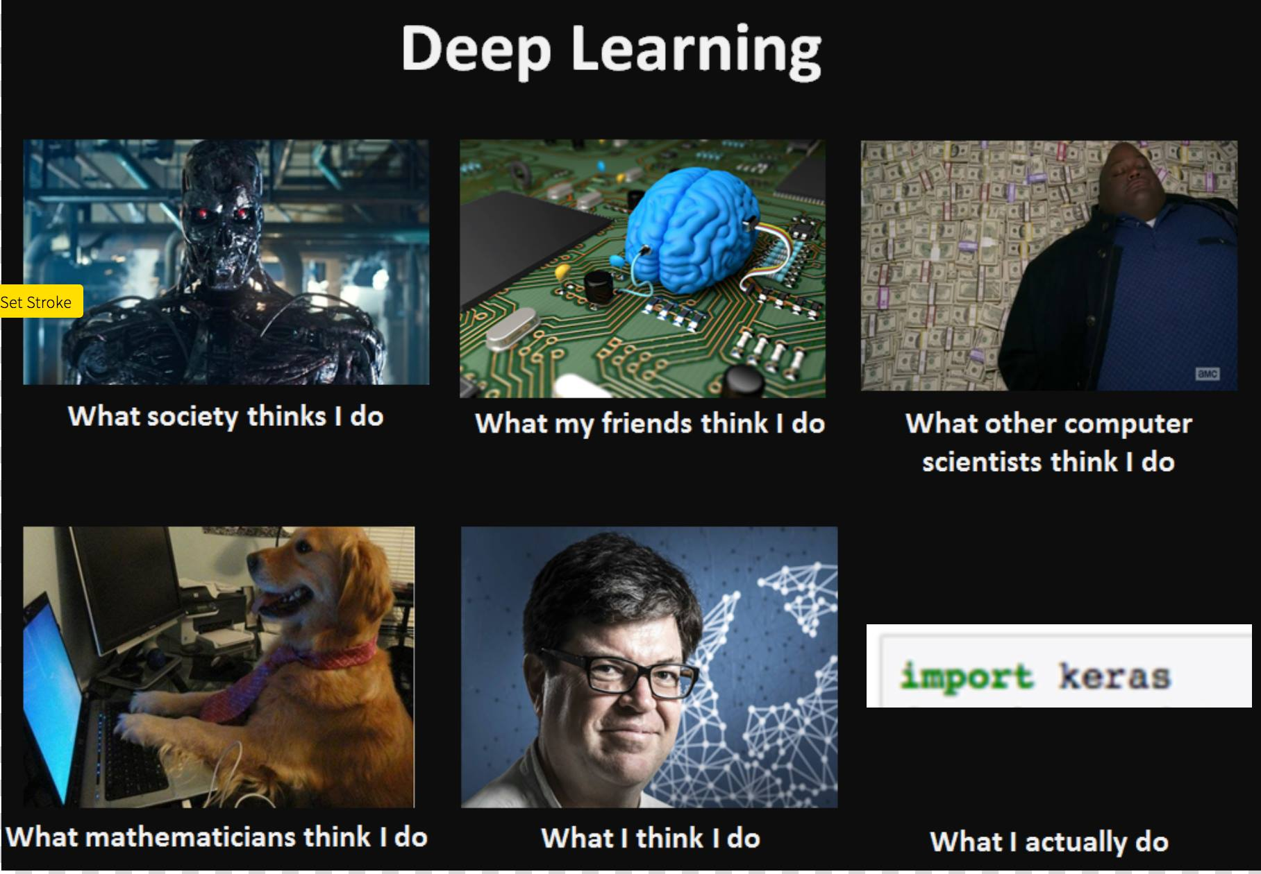
Thank You!

